Slide 1
What is Art?
The Basics: Part 1
How to identify and classify art
Who creates it?
What purpose does it serve?
What do artists do?
Where does the urge to create come from?
Characteristics of Art.
What is an aesthetic experience?
Art vs. Craft

Slide 2
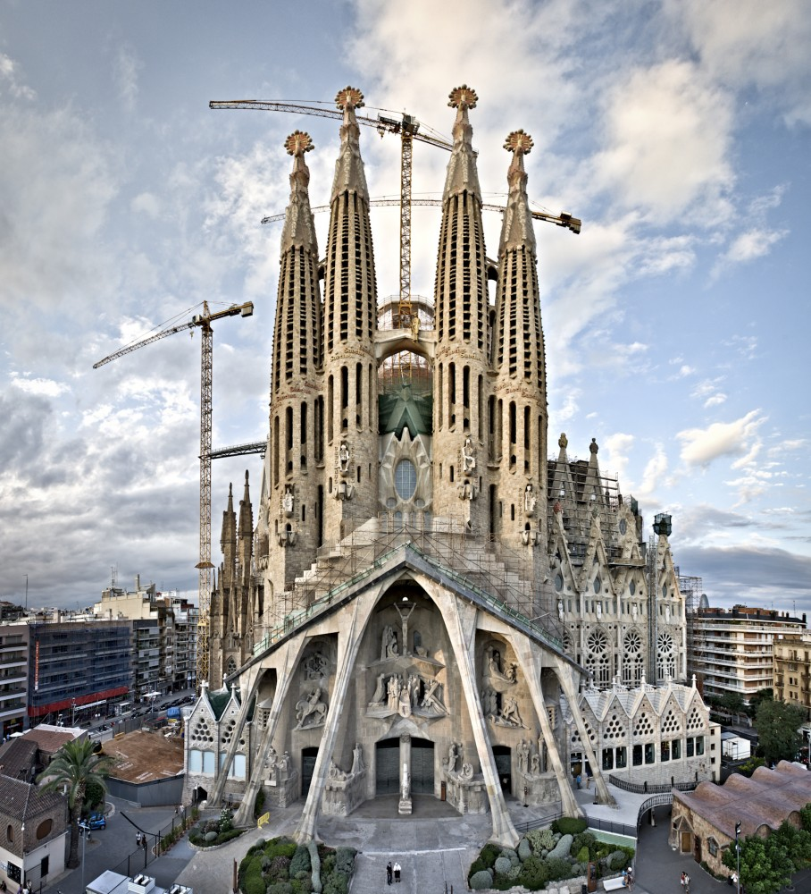
Art and History
5 Questions Art Historians Ask.
How old is it? Chonology
Physical, Documentary, Visual, or Stylistic evidence
Basílica i Temple Expiatori de la Sagrada Família: designed by Antoni Gaudi (1850-1926)

Slide 3
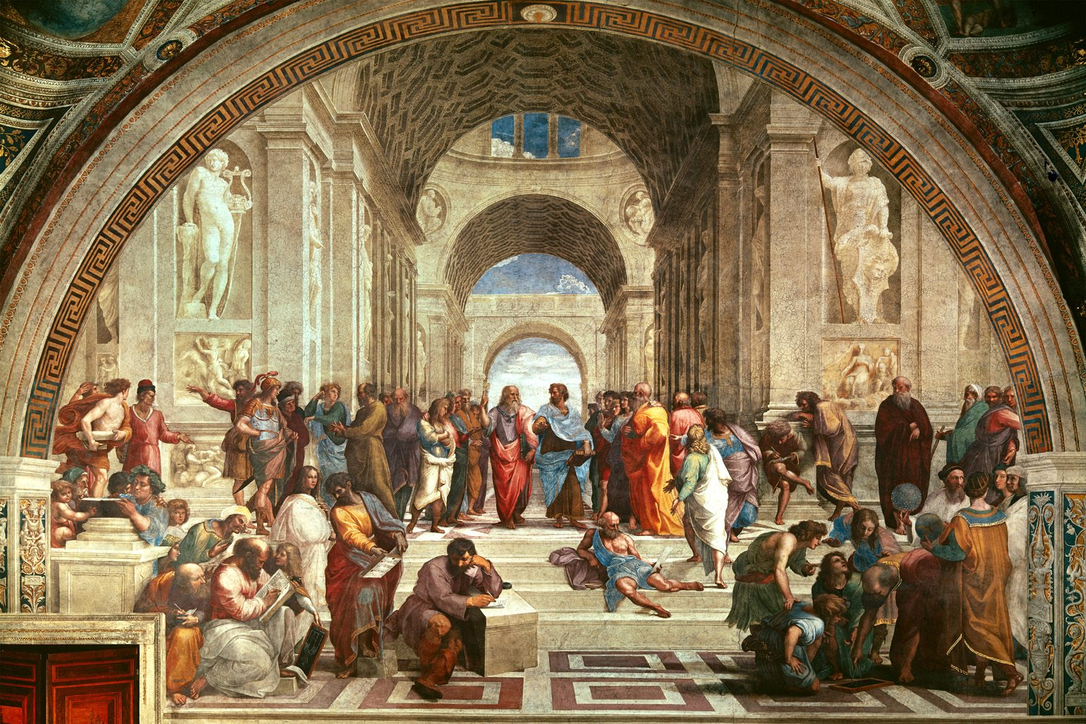
What is its Style?
Period
Regional
Personal
School of Athens, 1509–1511, Fresco, Vatican City, 500 cm × 770 cm (200 in × 300 in)

Slide 4
What is its subject?
Narrative?
Religious
Historical
Mythology
Genre (Daily life) Portrait
Landscape
Still life
Iconography

Slide 5
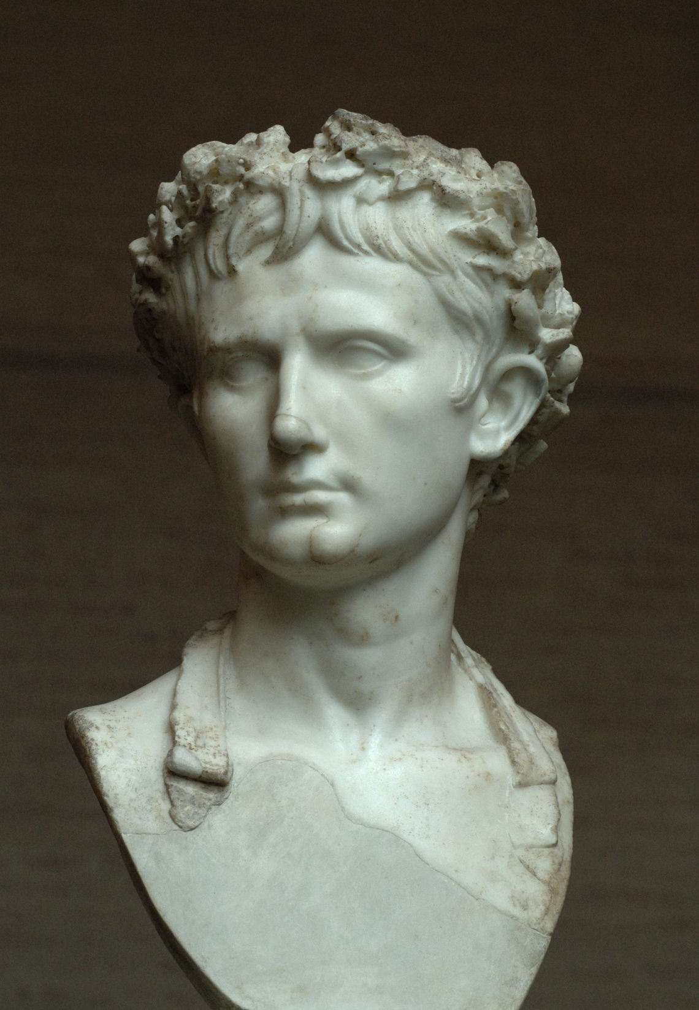
Artist and Patron
Who made it?
Who paid for it?
Augustus wearing corona civica (civic crown), early first century A.D. Marble, Approx. 1’ 5” high. Glyptothek, Munich

Slide 6
The Impulse for Art
Why do humans create imagery?
The Human Experience.
Early art included cave paintings, musical instruments, personal ornamentation, and portable sculptures became part of the cultural toolkit.
Painting of lions, Chauvet-Pont-d'Arc Cave, southern france, ~30,000 BCE
Notes:
Where does the urge to create

Slide 7
What do Artists do? 1. Create place for some human purpose
Stonehenge c.2000-1500 bce

Slide 8
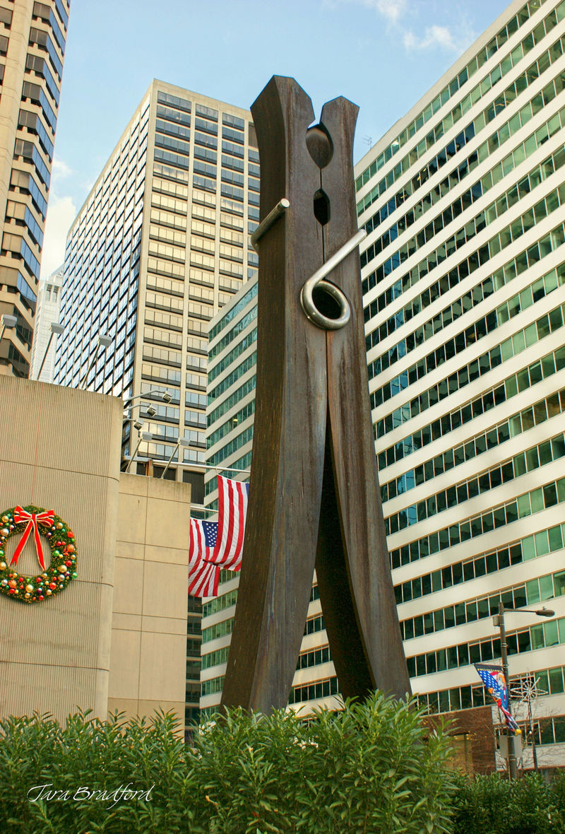
2. Create Extraordinary versions of ordinary objects
The tourist 2, Duane Hansen, 1988
Clothespin by Claus Oldenburg, 1976

Slide 9
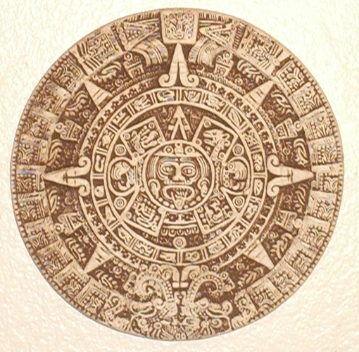
3. Record and commemorate
Mayan solar calendar. Dates back to at least the 5th century BC
Olmec head, 1500 -400 bce

Slide 10
The recording of cultures began with symbols and developed into cuneiform and hieroglyphs.

Slide 11
4. Give Tangible form to the unknown.
Shiva Nataraja. 10th century BCE

Slide 12
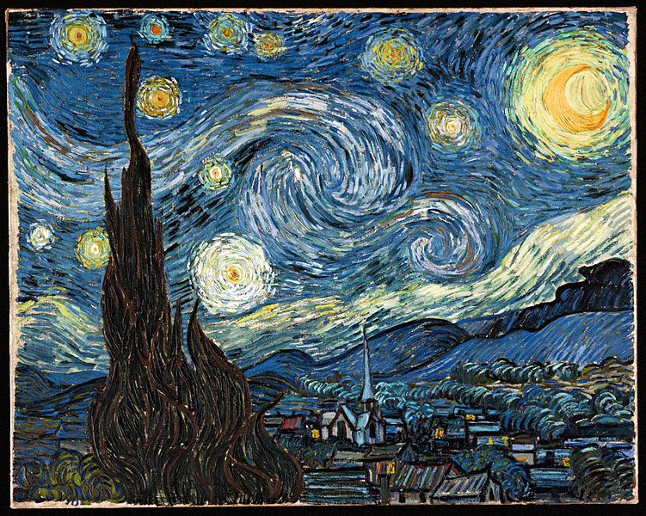
5. Give Tangible form to feelings and ideas
Vincent Van Gogh, Starry Night, 1889

Slide 13
6. Refresh our vision and help us see the world in new ways.
Marcell Duchamp, Fountain, 1917

Slide 14
Different ways of seeing
Audience/Viewer
Beauty
Appearances (representational/Abstract, nonrepresentational, Style)
Meaning (form/content)
Iconography (context)
Objects

Slide 15
Pablo Picasso, Guernica, 1937
Pablo Picasso, First communion, 1896

