Slide 1
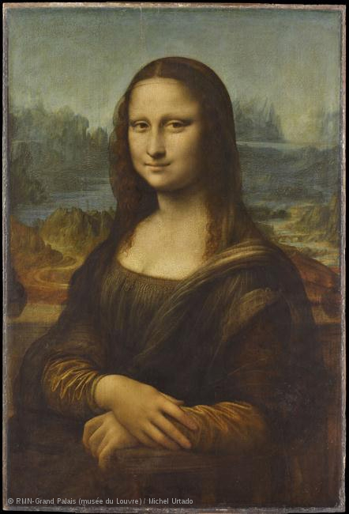
The Basics: Part 2
Part 1, we talked about the 5 questions art historians ask when they are looking at art as well as the 6 reasons why art is created. Part 2 we will delve into the elements of art, the principles of design, and art themes.
The Mona Lisa, Leonardo Da Vinci

Slide 2
Elements of Art
Line
Shape
Form / Mass
Light / Value
Color
Texture / Pattern
Space
What are the Elements of art?
Simply put the Elements are the building blocks of any work of art. All works of art have at least one or more Elements. There are varying lists but it generally stays around these 7.

Slide 4
Principles of Design
The Principles of design rely on the elements to create illusions. Think of the Elements as the various types of legos and the the Principles as the instructions used to create the pirates boat from the bag of parts.
Unity and Variety
Balance
Emphasis
Proportion and scale
Rhythm

Slide 6
What is a composition?
A Composition is what is created when the elements and principles are used together.

Slide 7
Art Themes
Art themes are the overall subject of a piece and in contemporary art usually fall into 7 categories. These themes can also fit the mold of historical art as well. The key thing to remember is that any given art can have one theme or multiple themes.

Slide 8
Identity
Self
cultural
The Body
Figurative
Body language
abstraction
Time
Using history in a new way
A specific moment in time
Place
A specific place for a specific reason
Location is the key
Language
Words a involved for a purpose
Interpretation
Science
Art that uses life
Art that depicts science
Spirituality
All things religion
Tribal beliefs
beliefs

Slide 9
Review Practice
For 10 of the following 21 images:
Find an answer to at least 2 of the 5 questions an art historian would ask
Identify one reason the artist created it
Identify at least 3 Elements and Principles used to create the composition
Identify it’s theme or themes
Google the names of the artist and or work to find more information on them. Some images you may find information on in the book.
***Your assignment this week will be to pin 6 examples of why artist create to a board you create titled “What is Art?” and answer all these bullet points in the description area.
****You may use an artist in powerpoints but you may NOT use the same work of art.

Slide 10
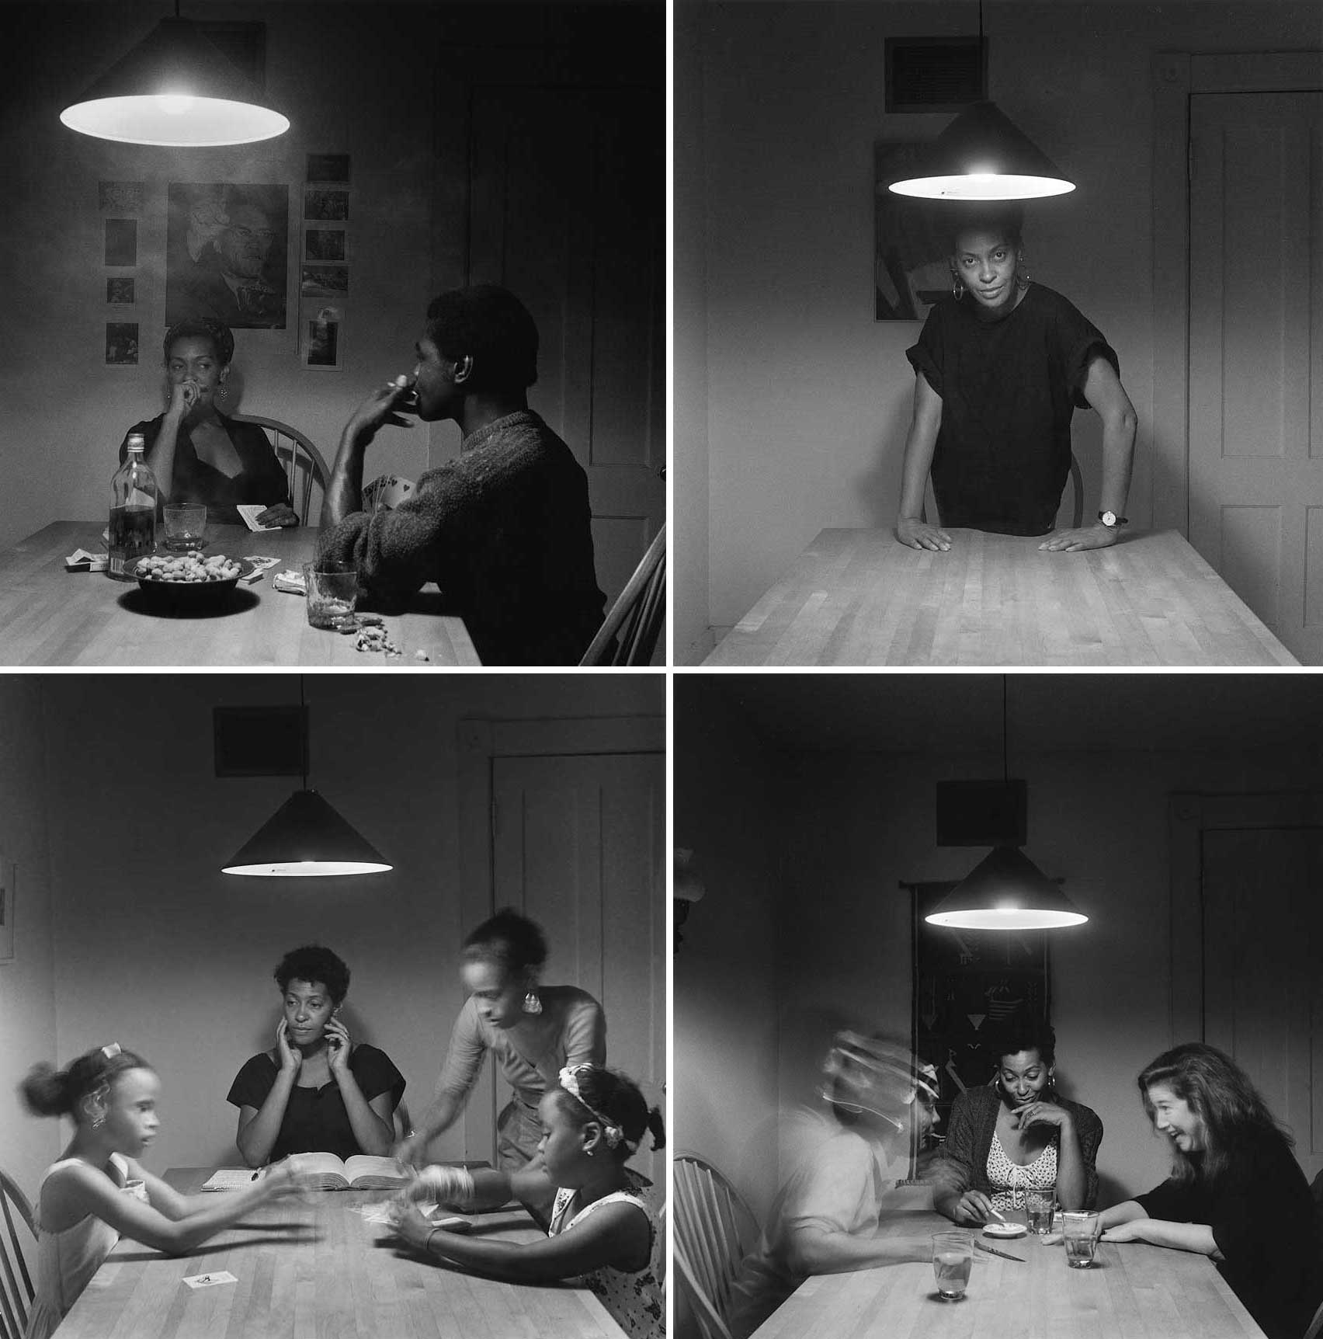
"Untitled," from Kitchen Table Series, 1989–90. Set of 20 gelatin-silver prints, 28 1/4 x 28 1/4 inches each. © Carrie Mae Weems. Courtesy Jack Shainman Gallery, New York.

Slide 11
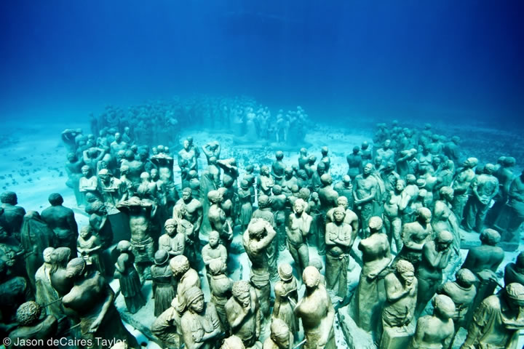
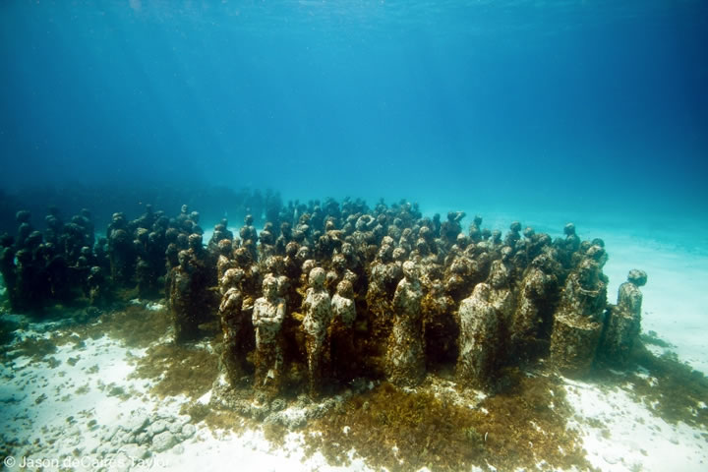
Silent Evolution
by: Jason DeCaires Taylor

Slide 12
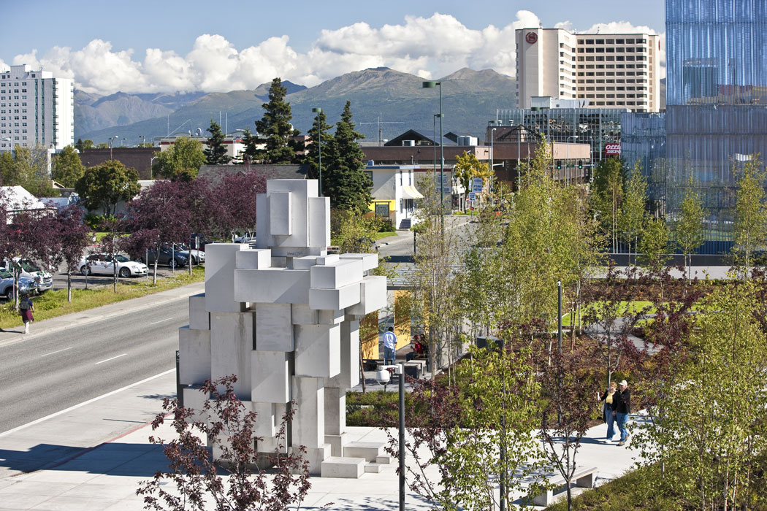
Antony Gormley, Habitat, 2010

Slide 13
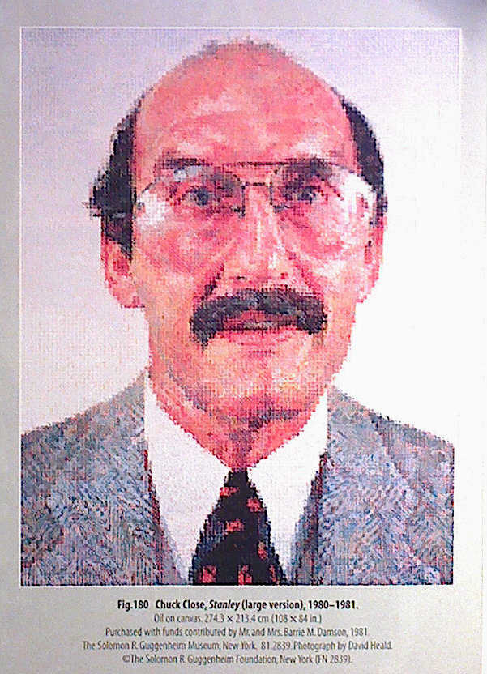
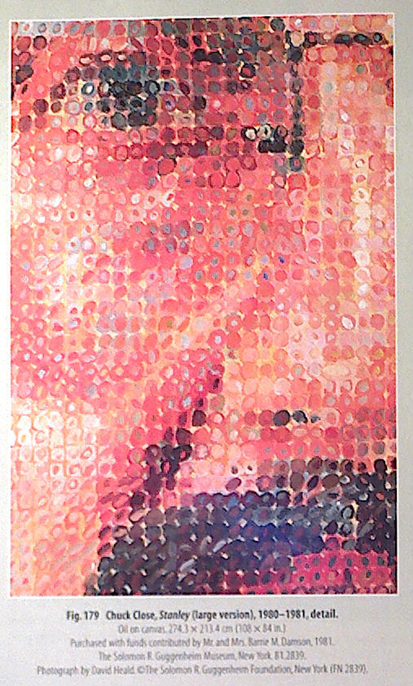

Slide 14
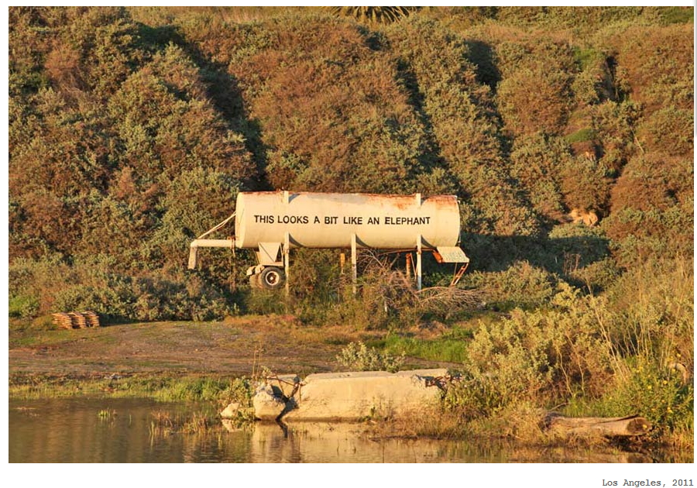
Bansky

Slide 15
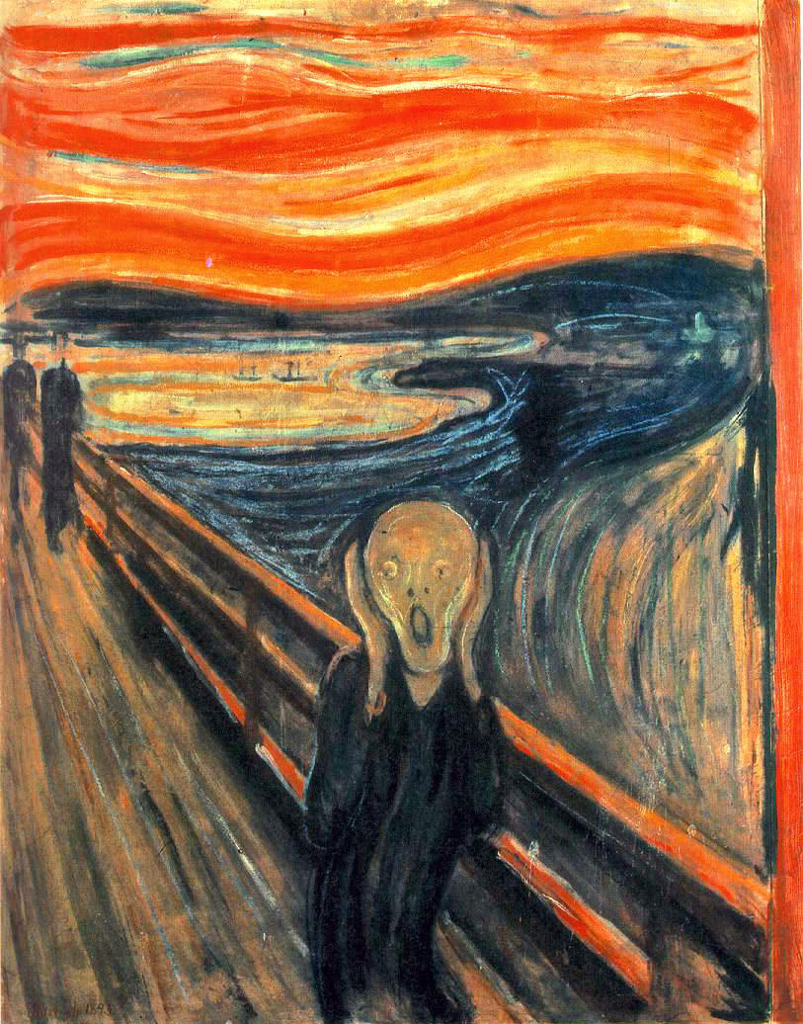
Edvard Munch, The Scream, 1893

Slide 16
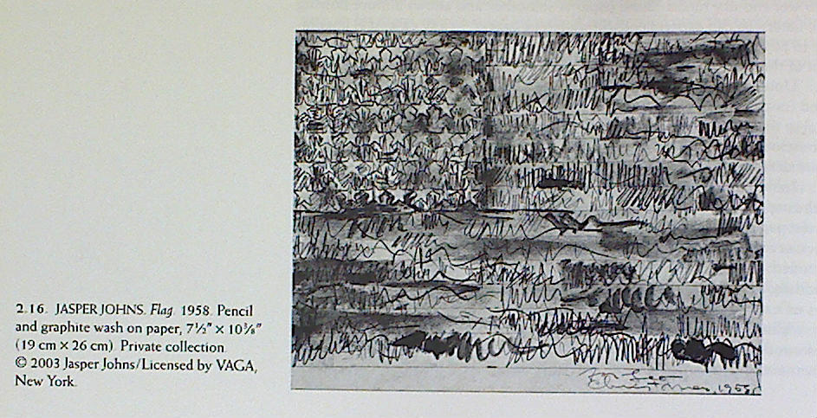

Slide 17
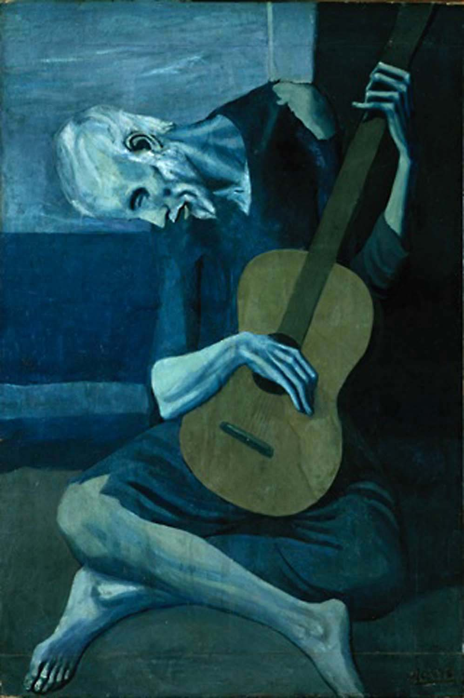
Pablo Picasso, The Old Guitarist, 1903

Slide 18
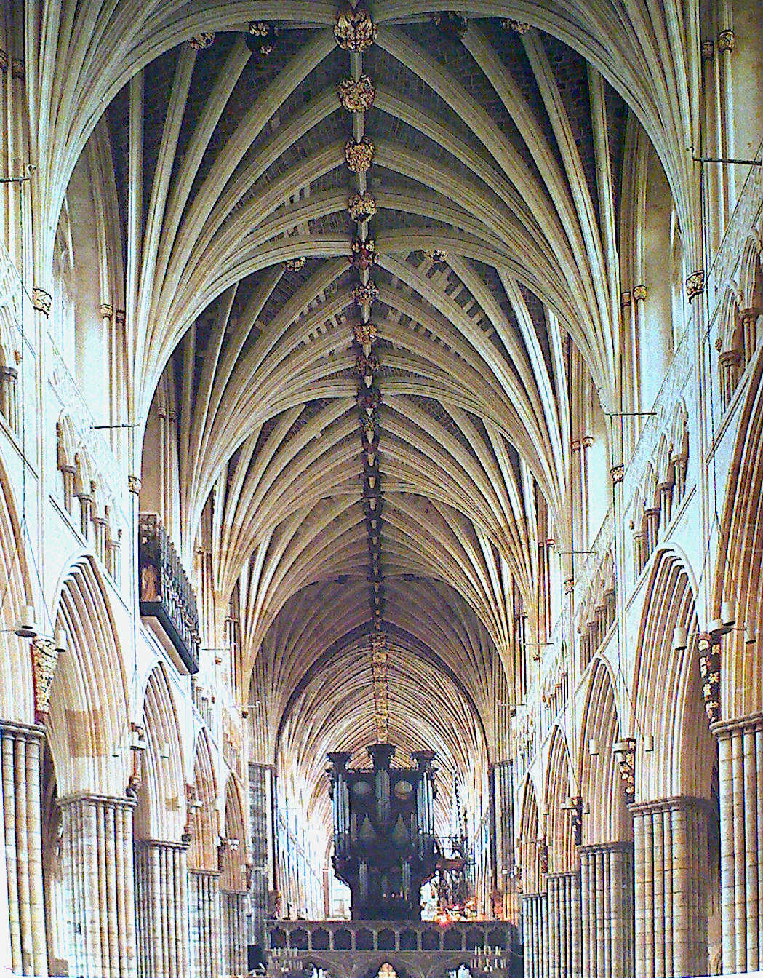
Vaults of the Nave, Exter Cathedral, 1280-1290

Slide 19
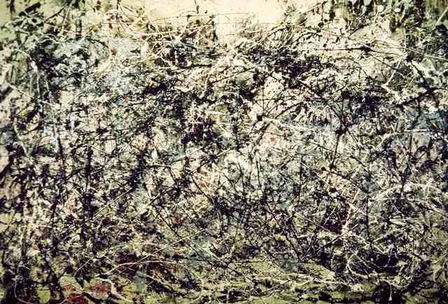
Jackson Pollock, no.1 1948

Slide 20
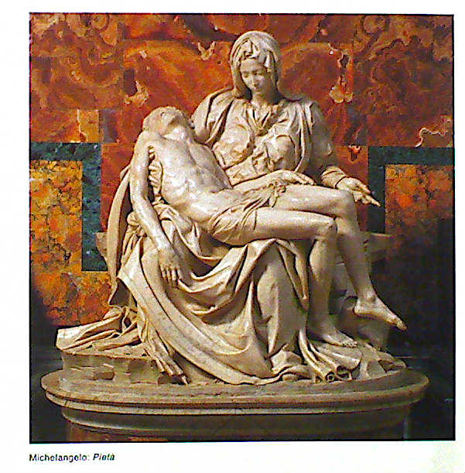

Slide 21
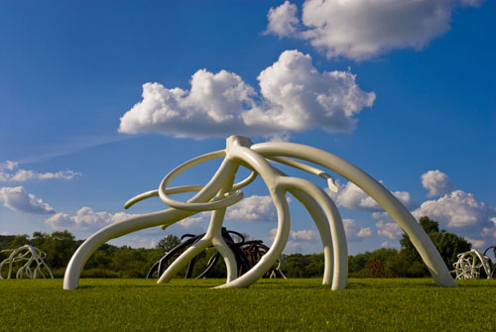
Steve Tobin, Steel Roots

Slide 22
Do Ho Suh, Karma, 2003

Slide 23
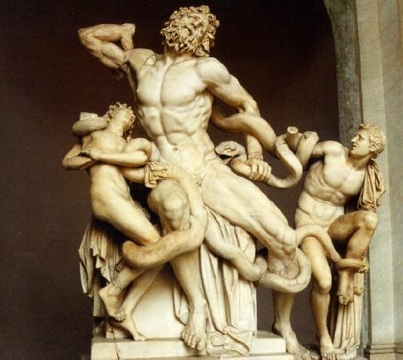
Laocoon and his sons, Hellenistic Greek, 323- 31 BC

Slide 24
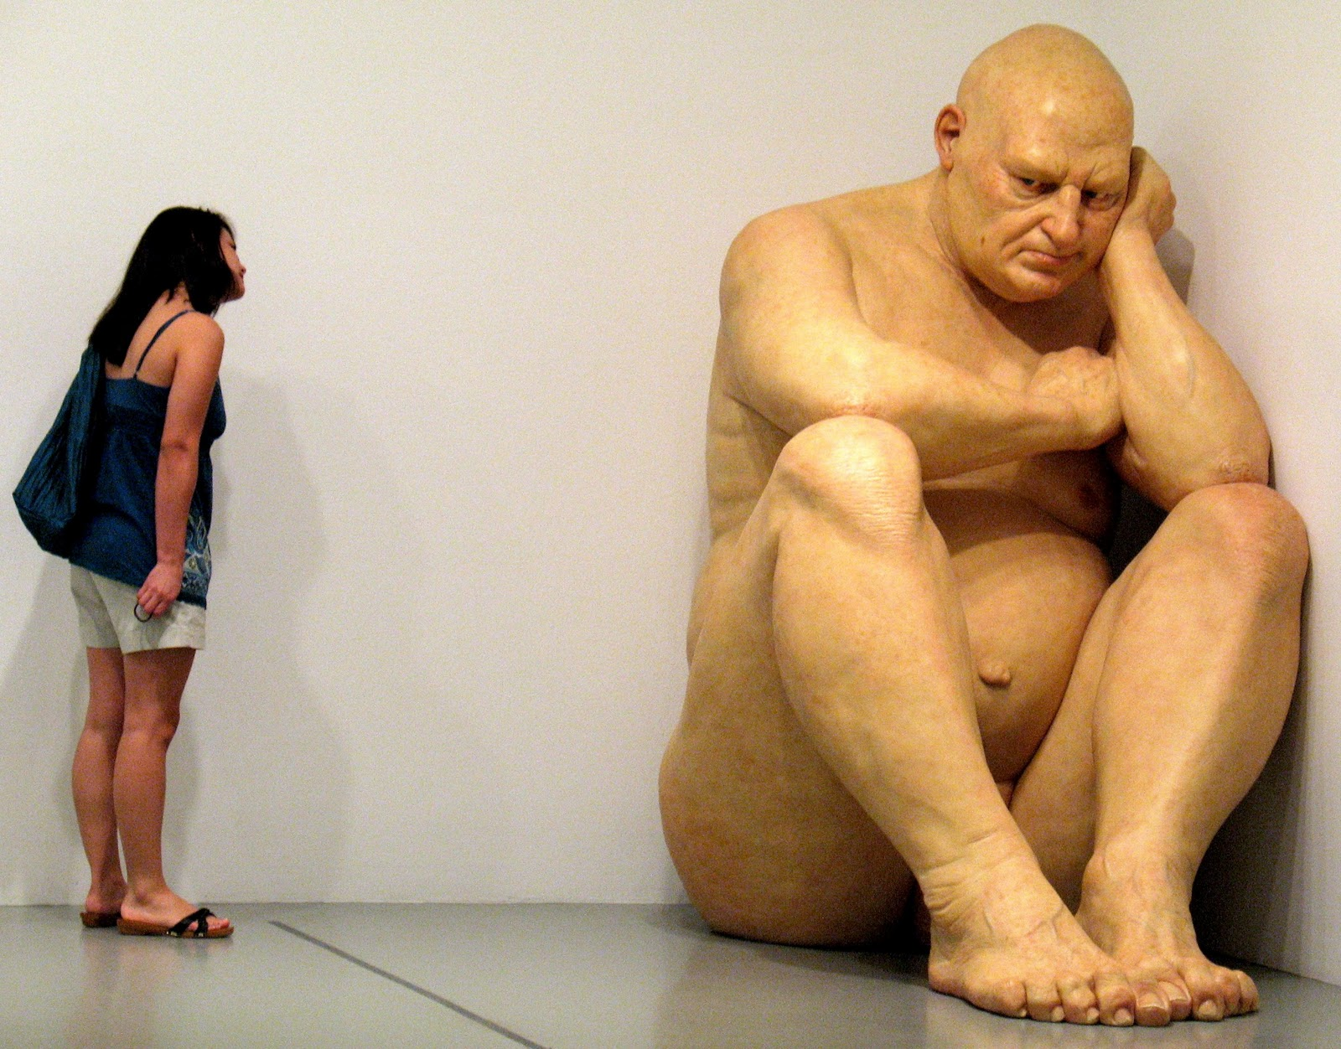
Big Naked Man by Ron Mueck

Slide 25
Cornelia Parker, Anti-mass, 2005
Notes:
Charcoal retrieved from a church burned by arson, nails, and wire

Slide 26
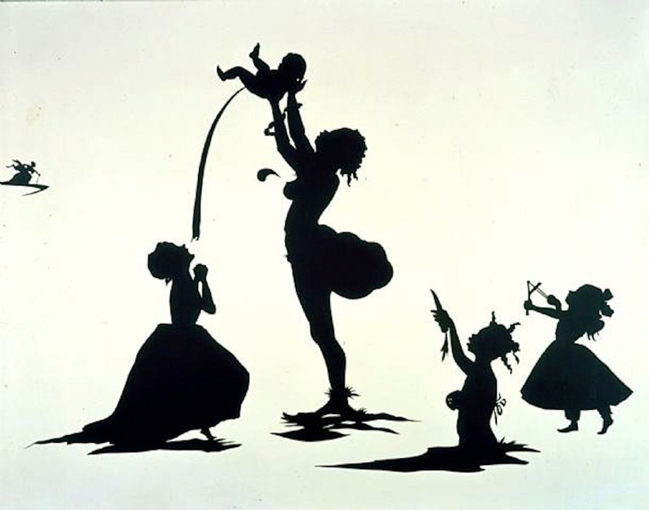
Kara Walker, Detail of Camptown Ladies, 1998
Notes:
Reframing the Past, Revisit history to change how we see the present. Walker Wants viewers to consider how representations of history can affect the present.

Slide 27
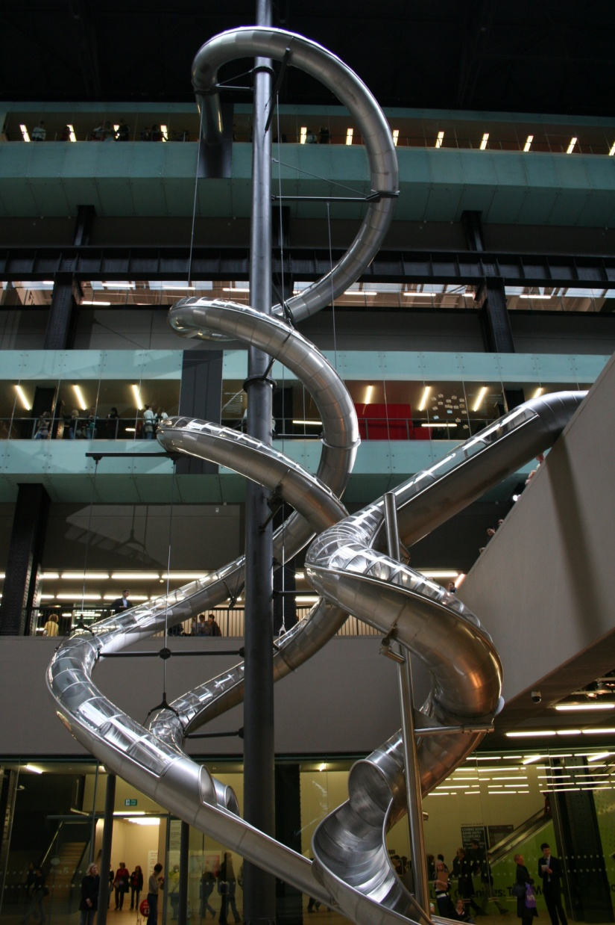
Carsten Holler, CE Test Site, 2006

Slide 28
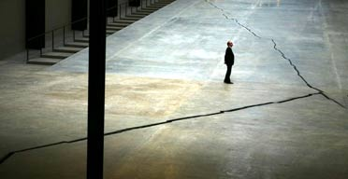
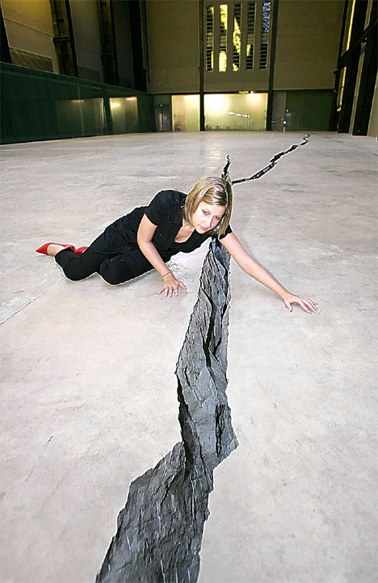
Doris Salcedo, Shibboleth, 2007

Slide 29
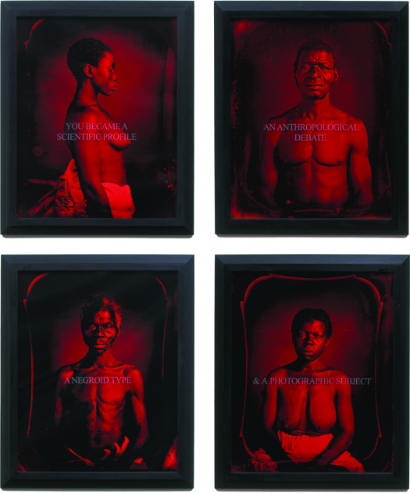
"From Here I Saw What Happened and I Cried," 1995. Selections from set of 30 C-prints with sandblasted text on glass, dimensions variable. © Carrie Mae Weems. Courtesy Jack Shainman Gallery, New York.

Slide 30
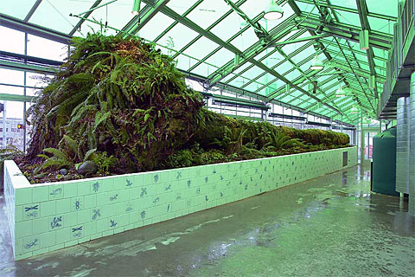
Mark Dion, Neukom Vivarium (2006) at the Olympic Sculpture Park, Seattle.

Slide 31
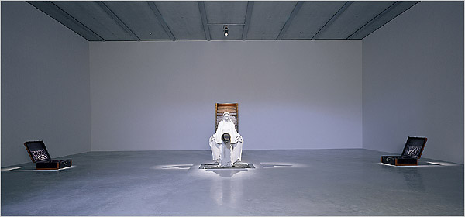
Robert Gober, An untitled work, 1995-97, features a cement Madonna, flanked by two Depression-era suitcases; the wooden staircase behind her has cascading water, and a subterranean grotto runs below it all.

