Slide 1
Event Review Due 4/7. Upload to Ecourseware
Write a 500-1000 word review about an art event of your choosing. Be sure to incorporate vocabulary and knowledge you have gained from this class so far.
What can you write about?
Any Museum preferably art (Local ex: Brooks, Dixon, Metal Museum, Civil Rights, Stax, etc....)
Local Live Band show (Minglewood, FedEx Forum, Dive Bars, Beale Street, ect….)
Local Parks with art (Overton, Memphis Zoo, Tigers around town and placement of them, ect…)
Architecture Critique (Churches, “Historic” Buildings, “Public” Spaces.
The point of this mid-term is to get you to do something you would not normally do or look at something you see in your daily routine in a new way.

Slide 2
Pick an Artist for Final Board/Presentations.
The same way you have posted boards this class you will create a presentation on an artist from the modern world for your final.
Any artist that has been presented in class slides or books are acceptable. If you have someone you have found, ask. All artist must be cleared by Mr. Williams. Here is a list to get you started.
Duane Hansen, Claus Oldenburg, Vincent Van Gogh, Marcell DuChamp, Maya Lin, Carrie Mae Weems, Do Ho Su, Ron Mueck, Cornelia Parker, Kara Walker, Carsten Holler, Doris Salcedo, Mark Dion, Robert Gobler, Jason DeCaires Taylor, Antony Gormley, Chuck Close, Bansky, Edvard Munch, Keith Haring, Jasper Johns, Jackson Pollock, Steve Tobin, Mike Kelley, Andy Warhol, Constantin Brancusi, Magdalena Abakanwicz, Wanxin Zhang, Ai Wei Wei, Christo and Jeanne- Claude, Willie Cole, Kehinde Wiley, Vik Munez, Grant Wood, Peter Voulkos, Albrecht Durer, Frank Lloyd Wright, Frank Gehry, HARUKA KOJIN, Yinka Shonibare, Louise Bourgeois, Cai Guo-Qiang

Slide 3
What’s Next?
What we have covered thus far:
What is Art?
What are the 6 reasons artists create?
Art Themes.
The elements of Art.
The oldest known art.
What causes the impulse for art?
The Principles of design
Characteristics of art.
The 5 questions art historians ask.

Slide 4
Dawn of Humanity
What is going on with the planet about 35,000 B.C.E.?
What is Migration and Agriculture.
archeology.
What is Human Nature?

Slide 5
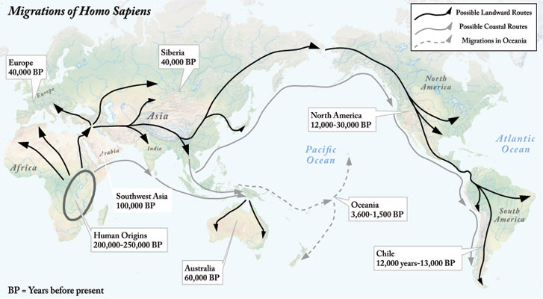
Migration

Slide 6
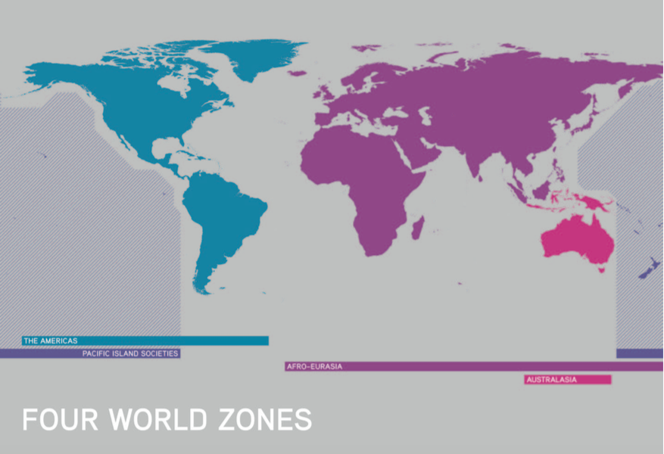

Slide 7
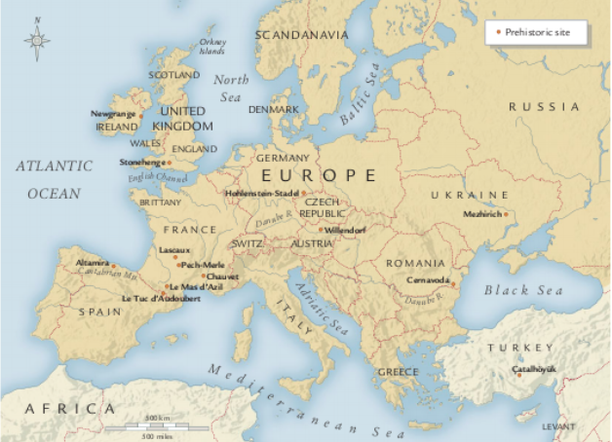
The Birth of Art Paleolithic
Hunters and gatherers
Small population
Tools become more sophisticated
Nomads
We have already discussed one of the caves that were painted but art from this era were not just paintings.

Slide 8
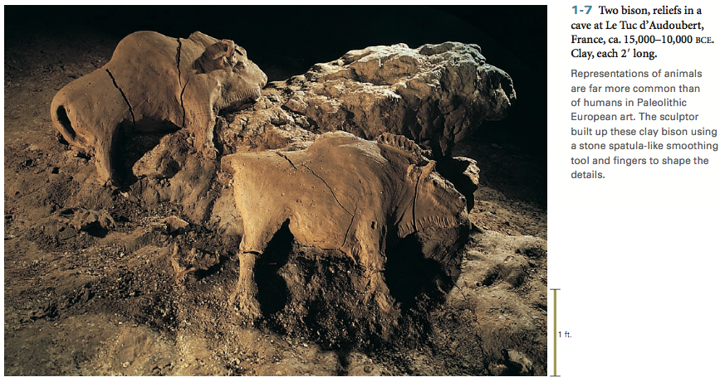
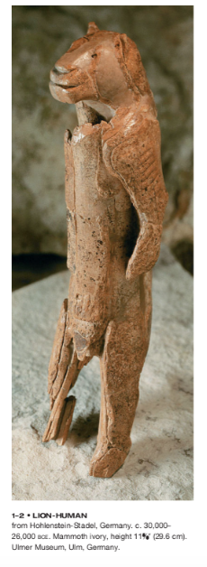
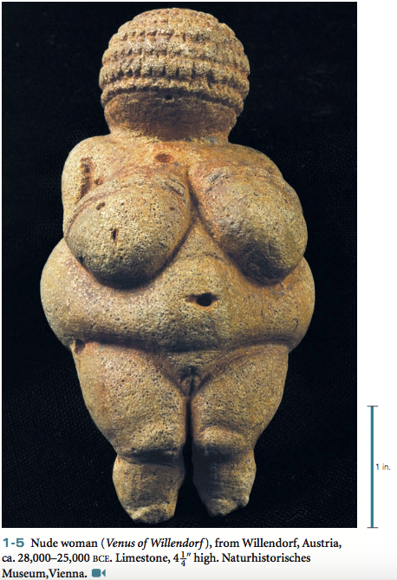

Slide 9
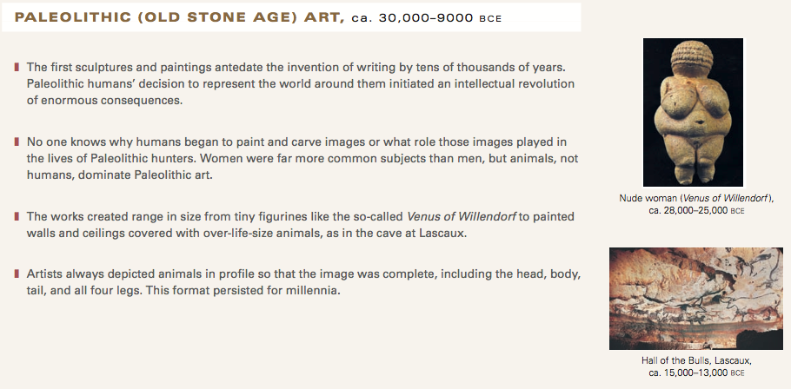
What materials are used?

Slide 10
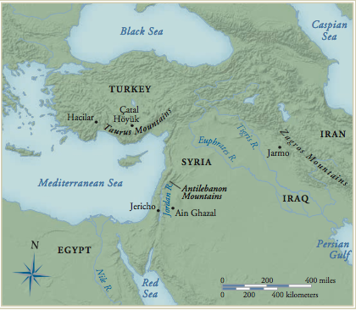
Neolithic Art

Slide 11
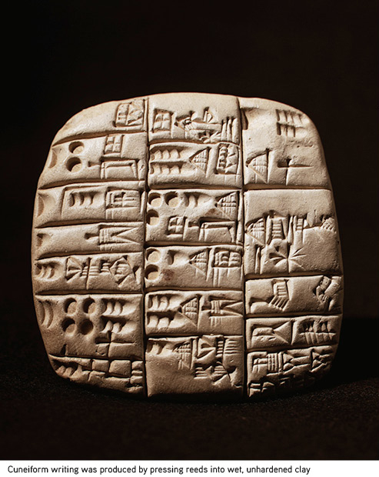
The Rise of Civilization ca. 8000 B.C.E.
Farming
Writing
Artisans
Domestication of livestock.
Cities begin to appear.

Slide 12
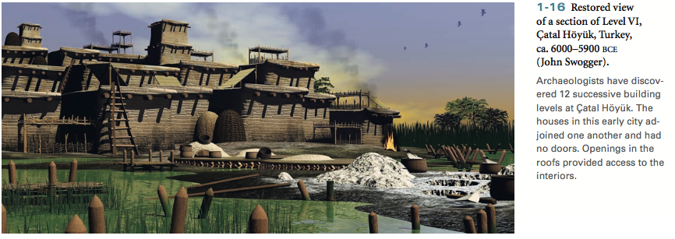
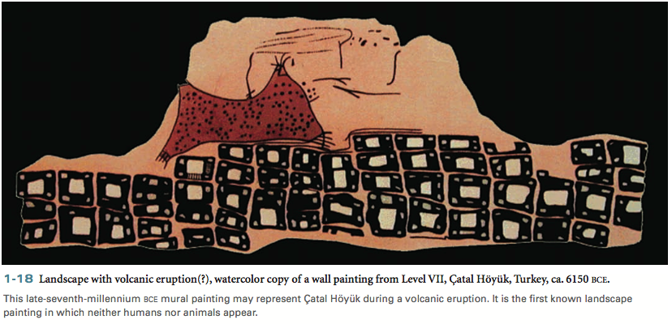

Slide 13
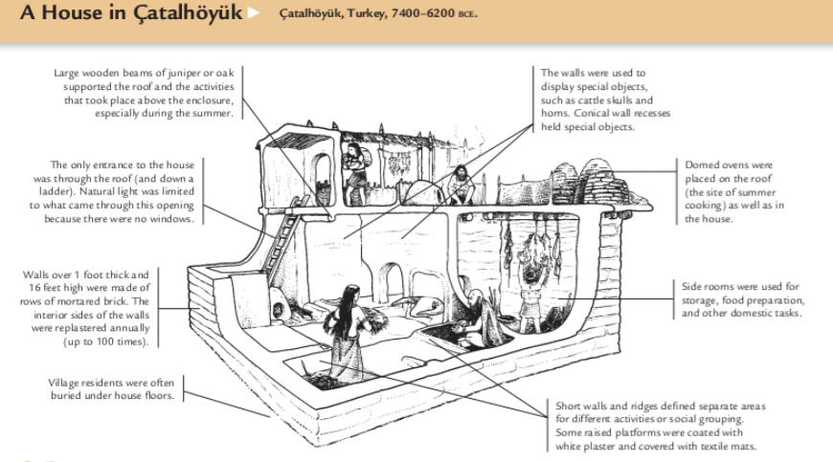
Catal Huyuk: One of the earliest cities

Slide 14
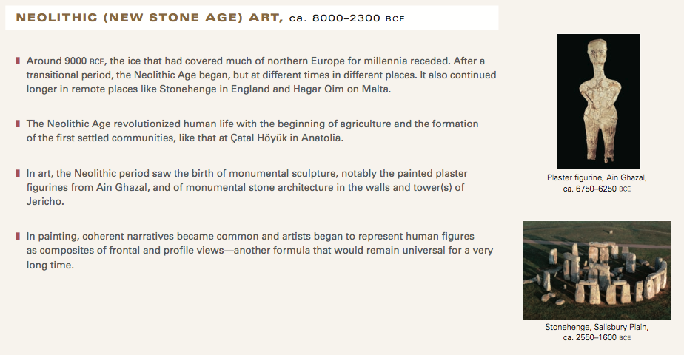
What types of Materials were used? What are some key events that changed humanity as we know it? We are seeing the beginnings of the early Civilizations.

Slide 15
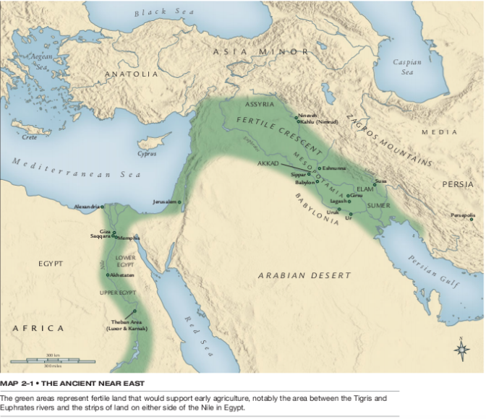
Dawn of Empires (The Ancient World)
Mesopotamia is at the core of the region known as the fertile crescent, a region that has given birth to three of the worlds modern faiths-Judaism, Christianity, and Islam. Walls became a standard for cities to protect its inhabitants by 8000 B.C.E. and evidence for the use of potters wheels, farming, and religion is evident.

Slide 17
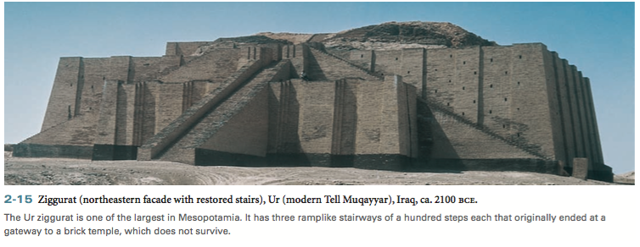
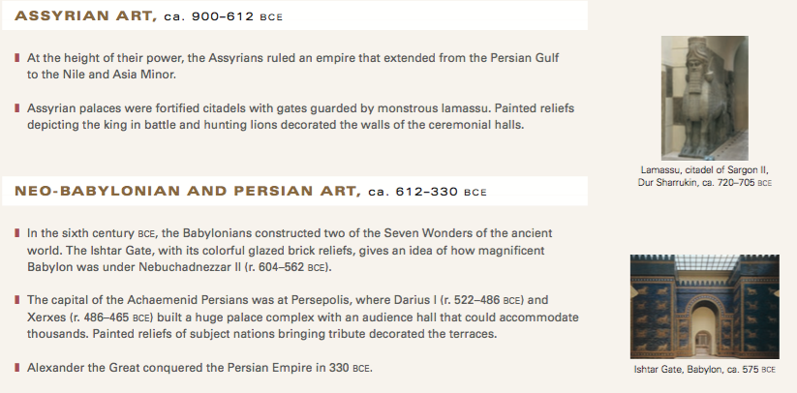

Slide 18
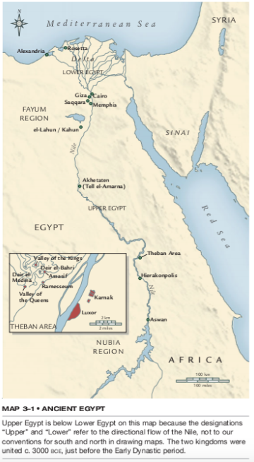
What do you know about the Egyptians?

Slide 20
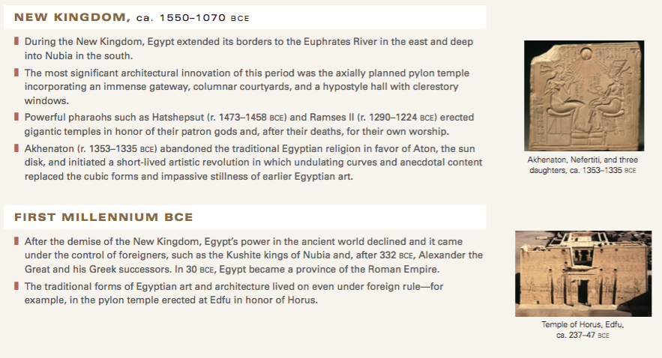
Egyptian culture Is one of the first Empires and last for more than 3000 years. Their sophistication in areas of architecture, science, astrology, and art are a result of their ability to traverse the Nile River for trade and movement of troops as well as irrigation for farm land and food to feed their numerous subjects.

Slide 21
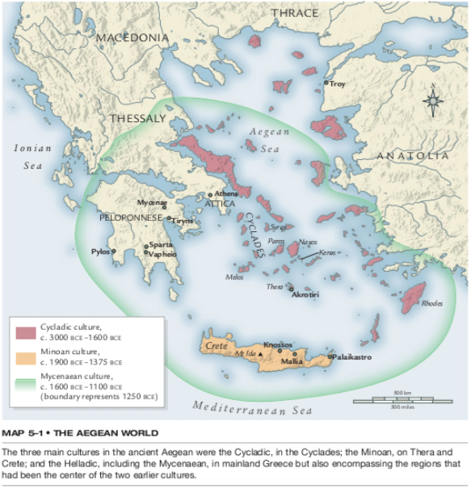
What do you know about the Aegean World?

Slide 22
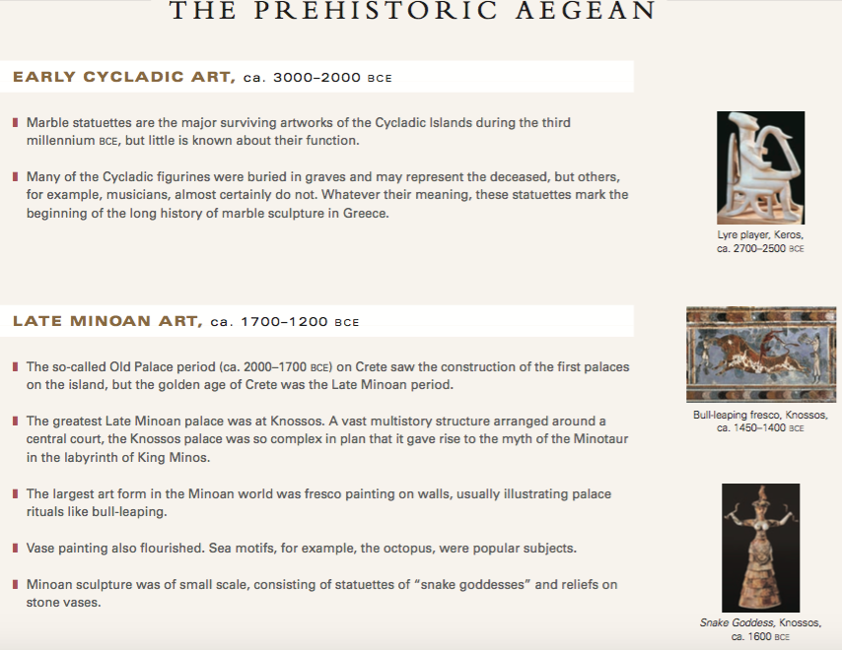

Slide 23
The Aegean World is the basis for the Greeks that followed in their footsteps. A volcano eruption and the conquering of Crete lead to the fall of the civilization, and allowed for the rise of the mainland Greek Culture.

Slide 24
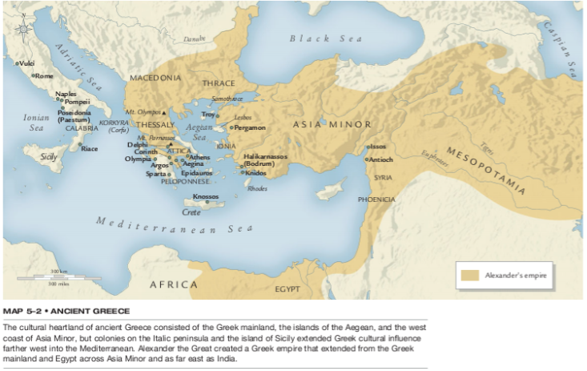
Greeks

Slide 25
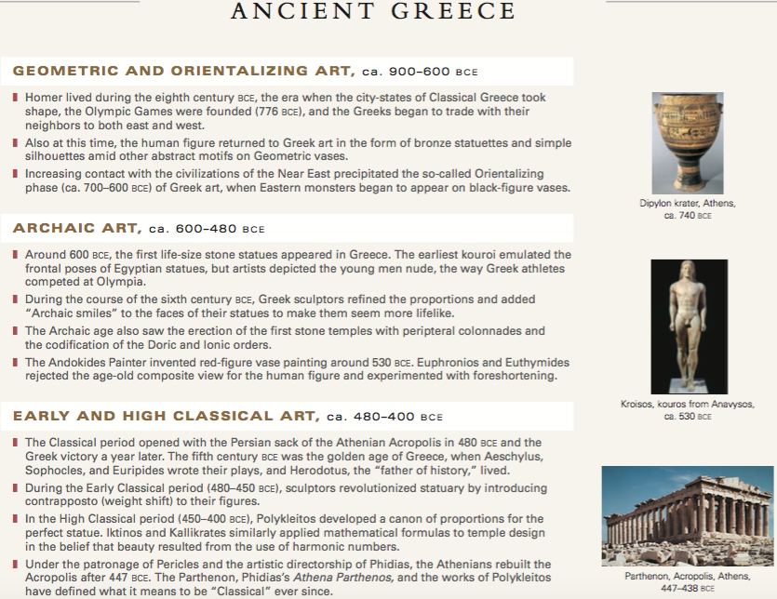

Slide 26
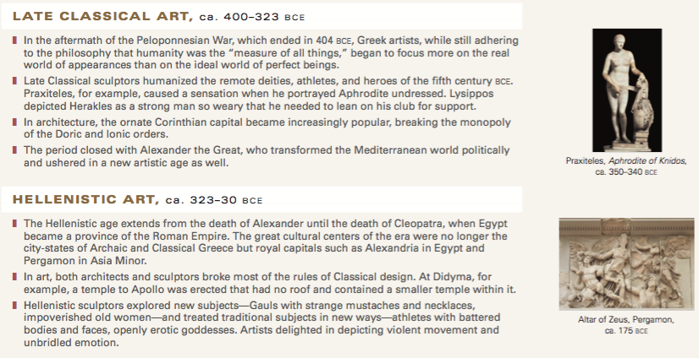
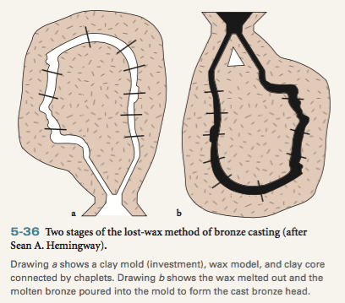
Greek culture created a new standard for philosophy, architecture, government, and techniques for making armor, weapons, and sculptures.

