Slide 1
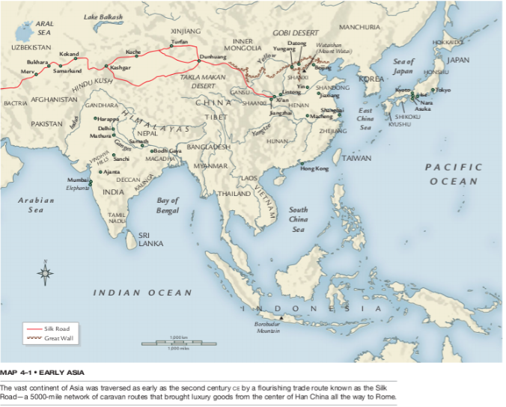

Slide 2
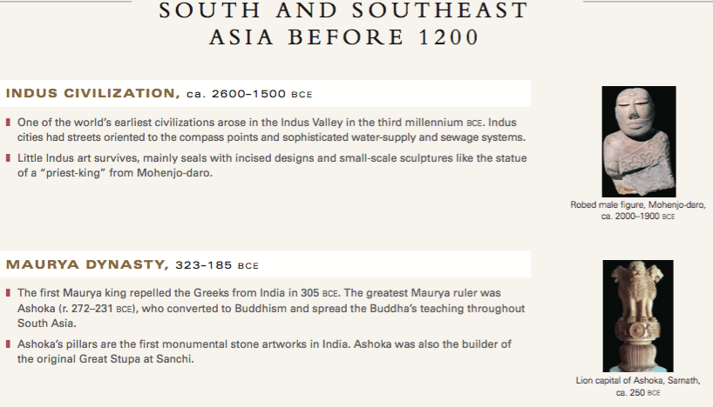

Slide 3
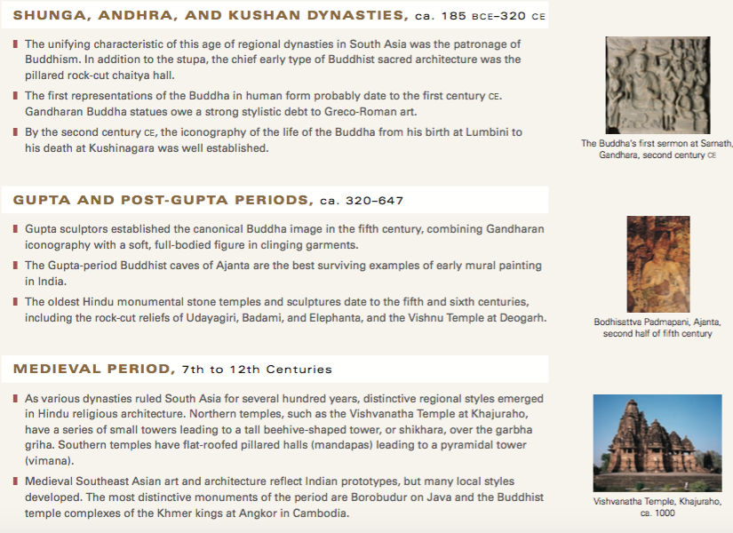

Slide 8
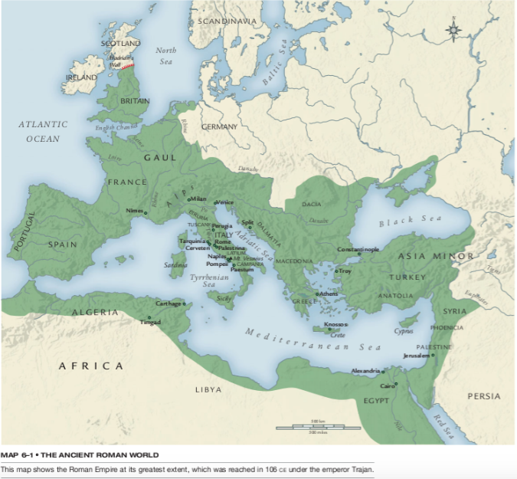
The Etruscans were the culture that the Romans wiped out to begin their empire. Native to Italy, similarities are found both with the Romans and Greeks due to trade and close proximity.

Slide 12
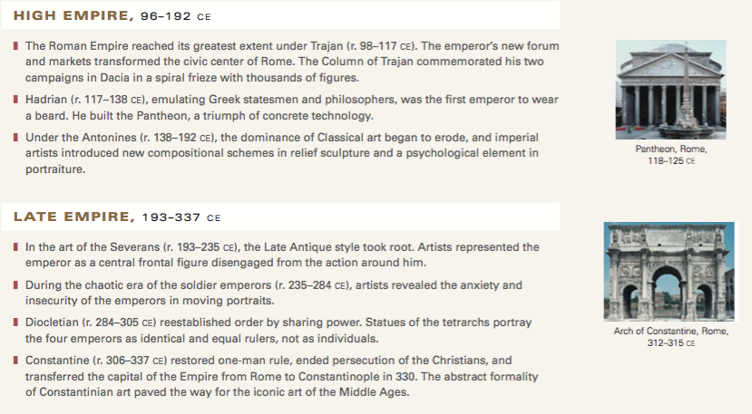

Slide 13
